Slide 1

CS 533 INTRO TO DATA SCIENCE
Michael Ekstrand

Slide 2
LOG ODDS

Slide 3
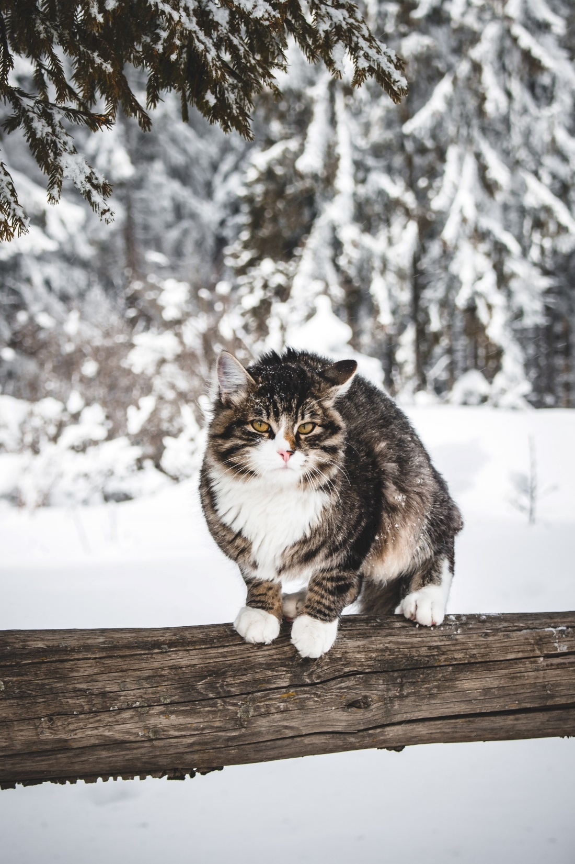
Learning Outcomes
Convert between probability, odds, and log odds.
Understand the function of the logistic and logit functions.
Photo by Madara Parma on Unsplash

Slide 4

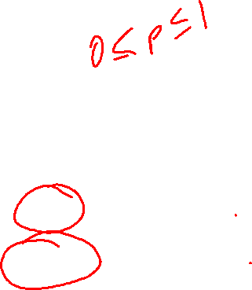
Odds
The probability of success: $P\left(S\right)$
The odds of success:
$$Odds\left(S\right)=\frac{P\left(S\right)}{P\left(S^{c}\right)}=\frac{P\left(S\right)}{1−P\left(S\right)}$$

Slide 5


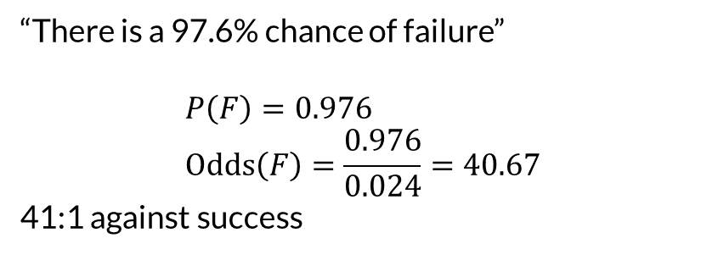
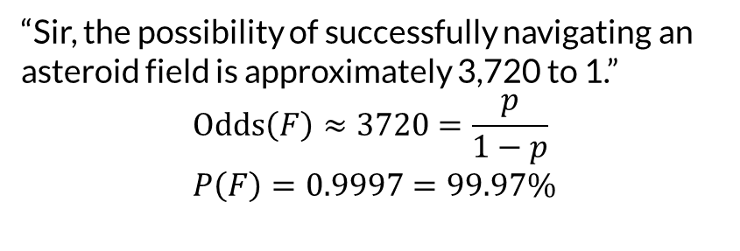
Probability and Odds
“There is a 97.6% chance of failure”
$$P\left(F\right)=0.976 \\ Odds\left(F\right)=\frac{0.976}{0.024}=40.67$$
41:1 against success
“Sir, the possibility of successfully navigating an asteroid field is approximately 3,720 to 1.”
$$Odds\left(F\right)≈3720=\frac{p}{1−p} \\ P\left(F\right)=0.9997=99.97\%$$

Slide 6
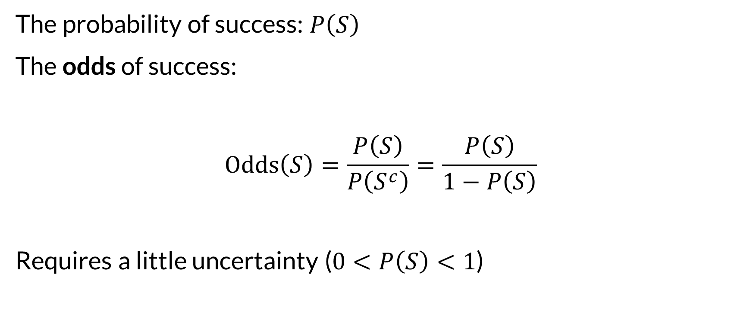
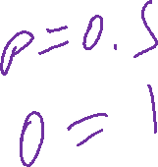
Odds
The probability of success: $P\left(S\right)$
The odds of success:
$$Odds\left(S\right)=\frac{P\left(S\right)}{P\left(S^{c}\right)}=\frac{P\left(S\right)}{1−P\left(S\right)}$$
Requires a little uncertainty ($0<P\left(S\right)<1$)

Slide 7
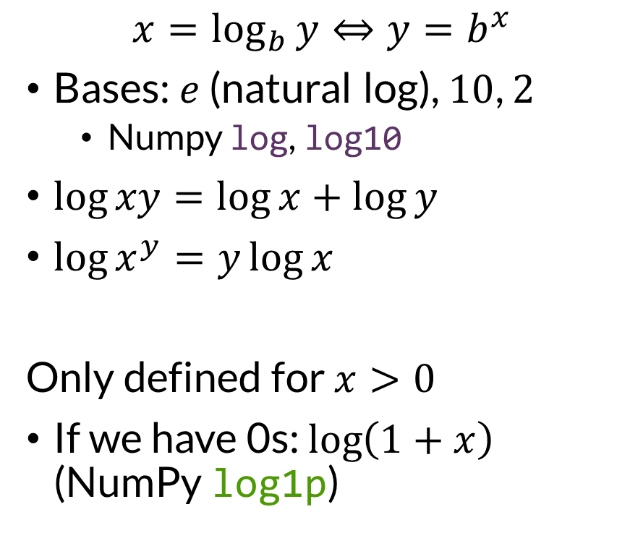
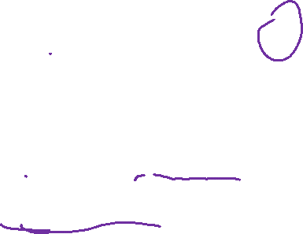
Logarithms
$$x=\log_{b}{y}⇔y=b^{x}$$
Bases: $e$ (natural log), $10$, $2$
Numpy log, log10
$\log{xy}=\log{x}+\log{y}$
$\log{x^{y}}=y\log{x}$
Only defined for $x>0$
If we have 0s: $\log\left(1+x\right)$ (NumPy log1p)
Very useful for compute
Avoid floating point over/underflow
Be careful though:
Addition and subtraction can compound errors

Slide 8
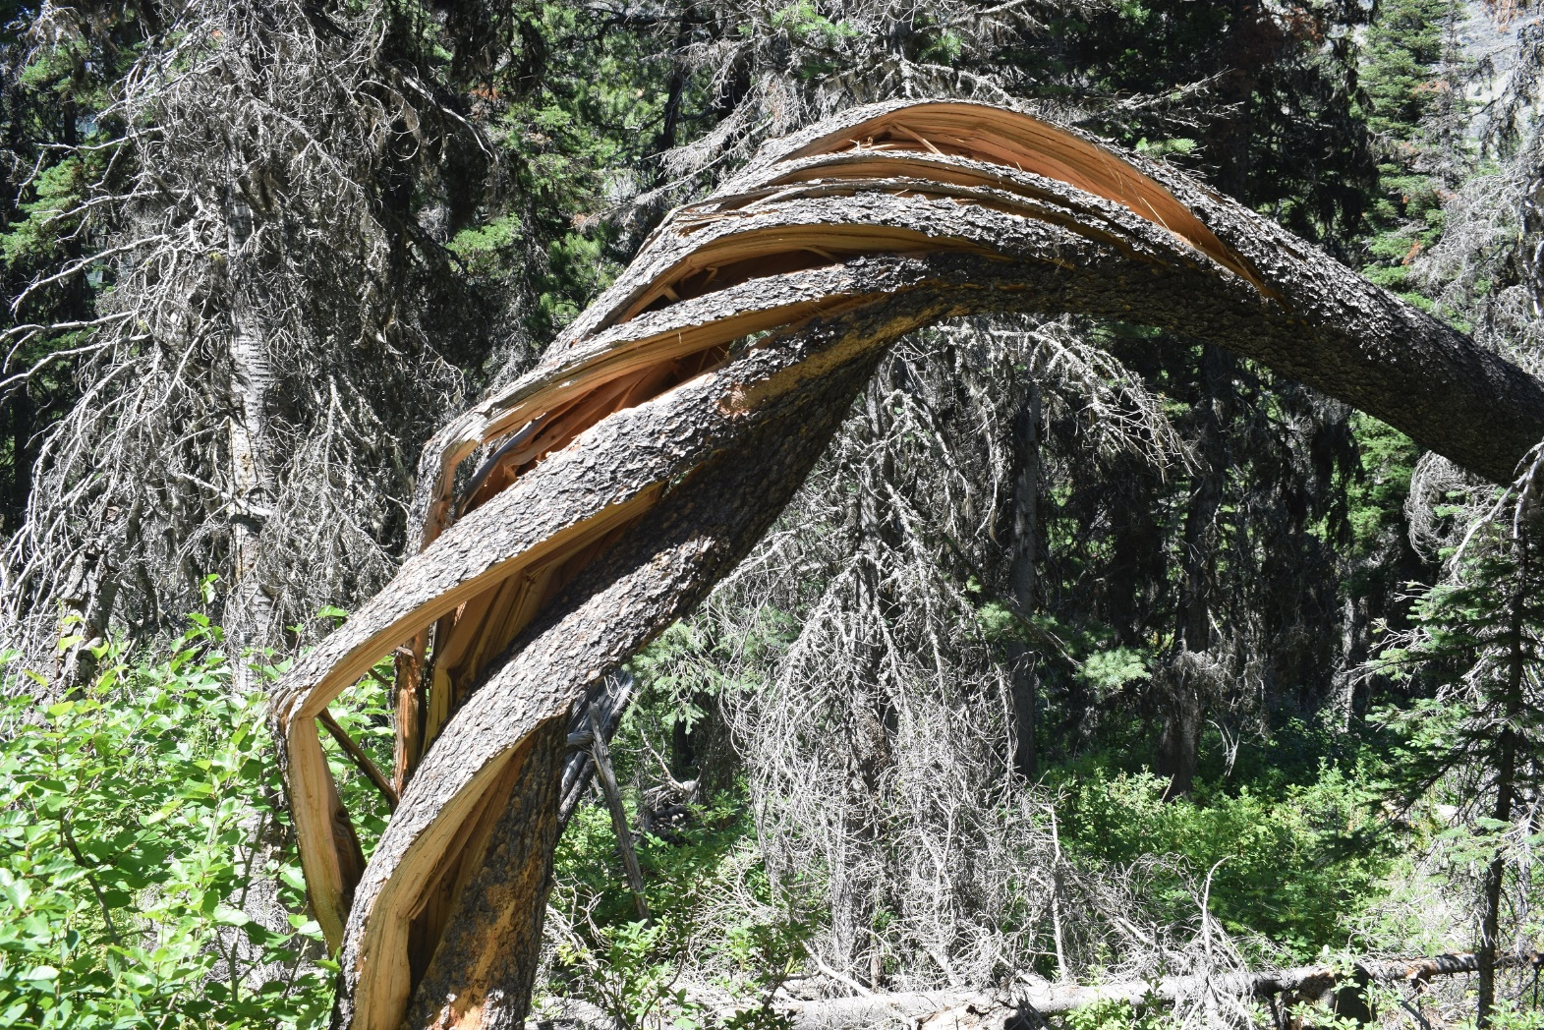
Odd Logs
Photo by Jennifer Ekstrand

Slide 9
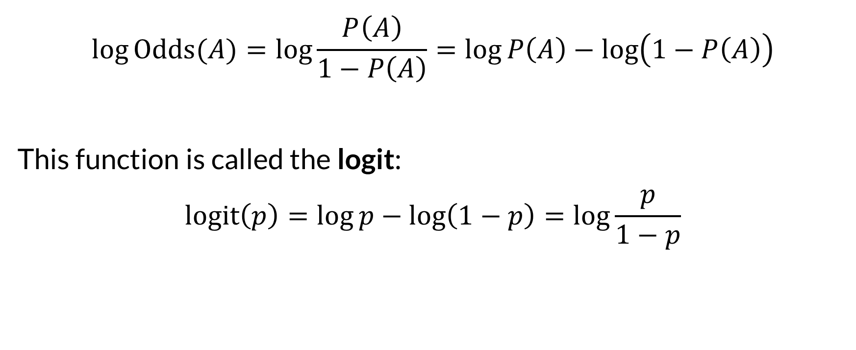
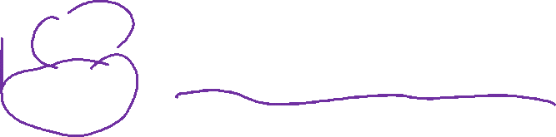
Log Odds
$$\log{Odds(A)}=\log{\frac{P\left(A\right)}{1−P\left(A\right)}}=\log{P\left(A\right)}−\log\left(1−P\left(A\right)\right)$$
This function is called the logit:
$$logit\left(p\right)=\log{p}−\log\left(1−p\right)=\log{\frac{p}{1−p}}$$

Slide 10
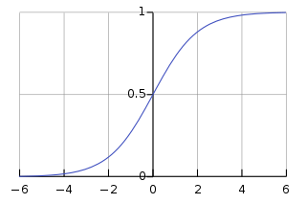
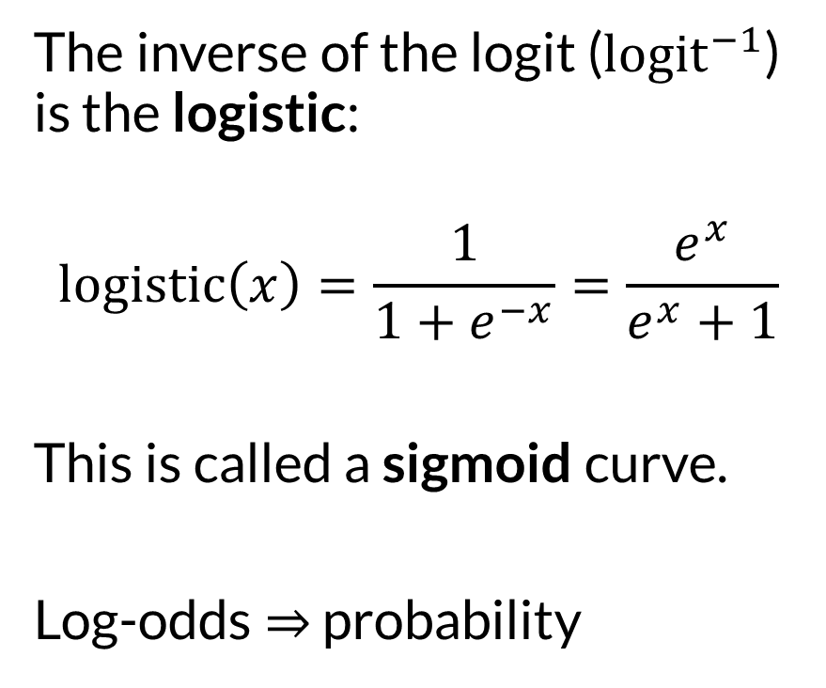

Logistic
The inverse of the logit (${logit}^{−1}$) is the logistic:
$$logistic\left(x\right)=\frac{1}{1+e^{−x}}=\frac{e^{x}}{e^{x}+1}$$
This is called a sigmoid curve.
Log-odds ⇒ probability
Diagram from Wikipedia

Slide 11
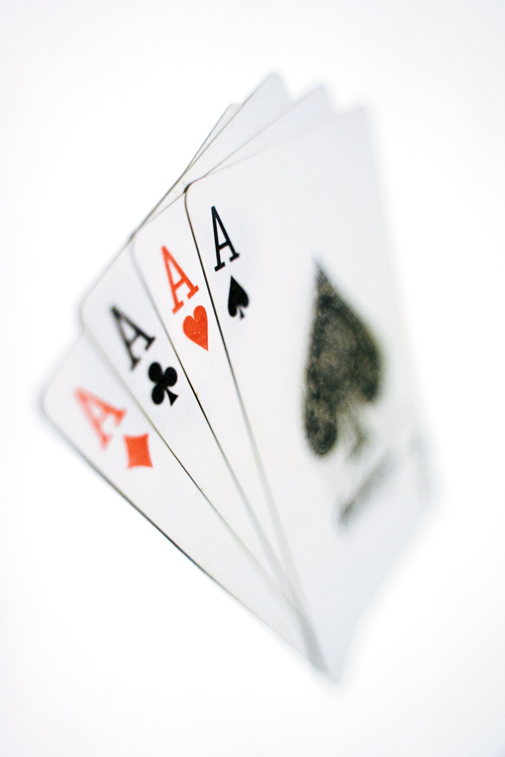

Wrapping Up
Odds are another way of representing probabilities.
The logistic and logit functions convert between probabilities and log-odds.
Photo by Praveen kumar Mathivanan on Unsplash

